Slide 1

Flick Stick
An Android Mobile Soccer Game
Anthony Menjivar
January 21, 2015

Slide 2
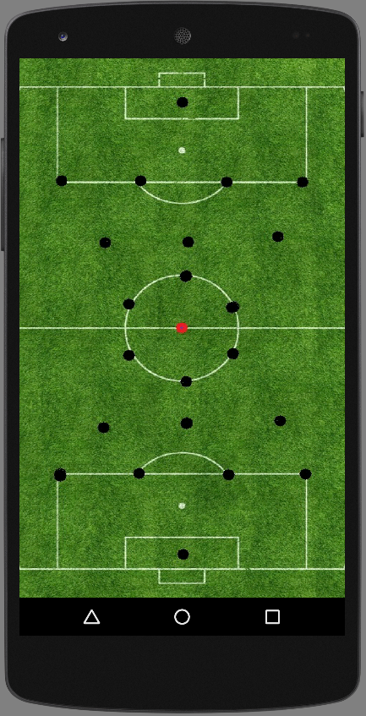
Flick Stick Description
Layout
Soccer Field
22 sticks (11 on each side)
Obstacles in Pre-Determined Formation
Game Play
2 players (1v1, 1vRobot, 1vOnline)
1st player flicks ball from starting point towards goal to score
Players take turns flicking the ball
First to certain amount of goals wins

Slide 3
Project Goals
Learn Steps for an Application
Work with Android APIs
Run a Smooth, Fun and Exciting Android Soccer Game
Beginning Steps for Game Development

Slide 4
Justification
Game Inspiration + Interest
Soccer
Video Games (Mobile)
Abilities
Java, Android, etc.
LMU Curriculum
Java, Data Structures, Graphics, etc.

Slide 5
Scenario
User is bored
User Takes out unlocks phone
User Opens Game
Game shows Menu
User chooses Robot
User chooses difficulty
Game Prompts
User Flicks Ball to Start play
Game continues and User Wins
User goes back to menu
User exits game

Slide 6
Use Case Diagram
Play Game/Flicks Ball
Open Game
Chooses Difficulty
Play Again
Menu
Select Play Robot
Player Wins or loses
Terminates Game
Return to Menu

Slide 7
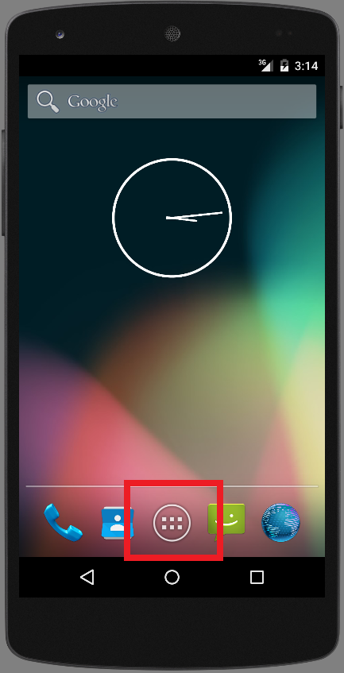
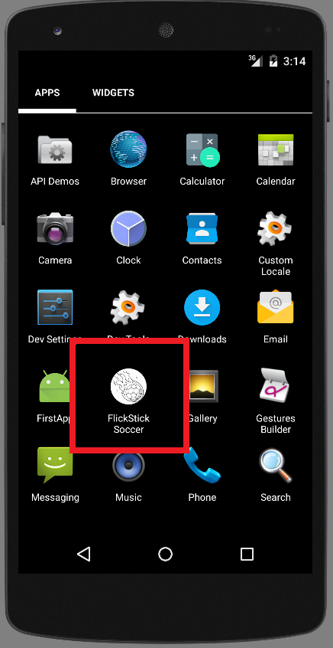
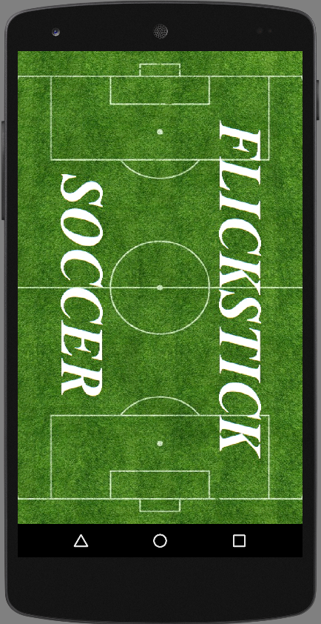
Screen Shots

Slide 8
Class Diagram
User
userName()
userLevel()
Game
Robot
renderSprites()
renderLayout()
getBallLocation(int, int)
getScore()
robotDifficulty()
robotNextMove()

Slide 9
State Diagram
Start
Game Load State
Terminate Game
Game Menu State
Tournament
Online
Robot
2 player
Connect to Player
Choose Difficulty State
Game State
Pause Menu

Slide 10
Project Challenges
Learning as I go
Falling behind
Use on different devices (screen sizes)
Android (Framework, APIs)

Slide 11
Status Update
Accomplishments
Load Application onto Nexus 5 Phone
Coded the games framework on Android
Finished all game sounds
Began coding game activities & States
Plans
Finish development of all graphics & sprites
Finish Game Framework on Android
Research mirroring game on multiple phones/Connecting game to network

Slide 12
Thank You!

